Slide 1
Applications

Slide 2
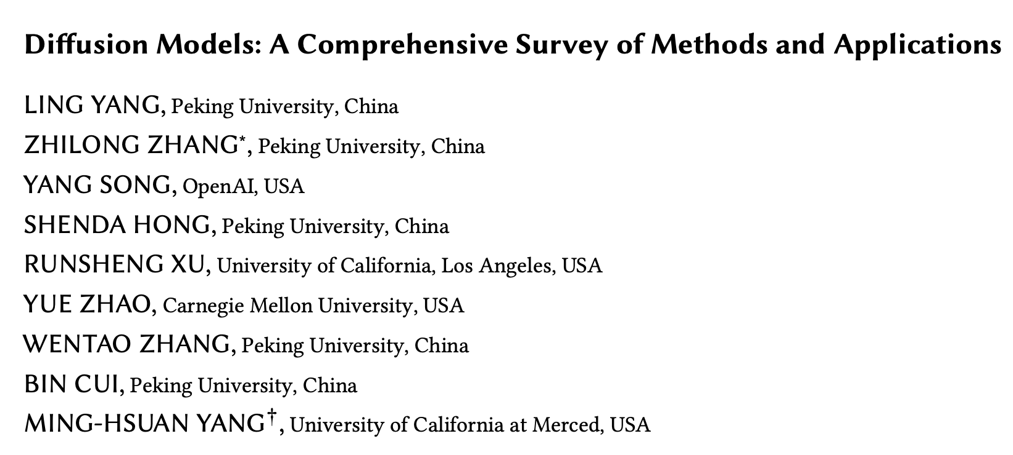
Applications
Overview
Unconditional and Conditional
Computer Vision
Segmentation
Video generation
Point clouds
Anomaly detection
Natural Language Generation
Multi-modal Generation
Text-to-something
Temporal Data Modeling
Time series imputation
Forecasting
Signal processing
Interdisciplinary
Drug design
Materials
Medical imaging
Notes:
Generally across the university I have found that people either haven’t heard of diffusion models, or they simply don’t make the connection between diffusion models and DallE, Midjourney etc.
Importantly, diffusion models are extremely flexible.

Slide 3
Applications
Diffusion model paradigms – (un)conditional and classifier(-free)
When we talk about “conditioning” a model, we are usually referring to additional information fed to the model
Unconditional generation is simply following the DDPM algorithm with no text labels.
But we can also just generate content without any guidance – this is unconditional generation
There are a few main types of conditioning mechanisms:
Concatenation
Gradient-based
Cross-attention
Classifier vs classifier-free
Classifier – train an additional classifier to guide the model.
Complicated, begin to approach GANs.
Classifier-free – mix the score estimates of a conditional model and an unconditional model.
Notes:
Before we look at applications, I’d just like to highlight two important ways of using diffusion models – unconditional vs conditional generation.
Concatenation Exactly like it sounds – you take your additional information and concatenate it with intermediate denoised targets in the diffusion process.
Gradient Incorporates a task related gradient. For example, you might have a diffusion model, and then train an additional classifier on noisy images. You then use the gradients to guide the diffusion process towards an arbitrary class label.
Cross-attention Attentional message passing between the guidance and diffusion targets. Usually conducted in a layerwise manner. If you remember back to the architecture of SD, we had these cross attention connections from the guidance process to the layers of Unet.
AdaLN Adaptive normalization layers.
We might want to introduce class information to our model. For example, suppose we are training a model to generate hand-written digits. We might pass in the class label as a feature by concatenating it with the feature maps. But it will only have a weak effect on the model.
Instead we can just train an additional classifier model. At every step of the diffusion process, we just have the model guess the class, and then add the loss to the loss calculation of the diffusion model.

Slide 4
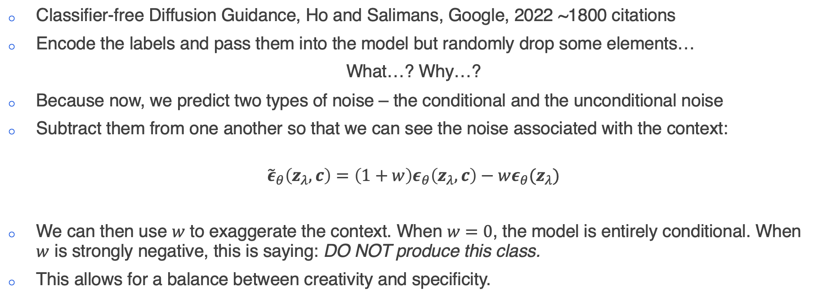
Applications
Classifier-free Guidance
Classifier-free Diffusion Guidance, Ho and Salimans, Google, 2022 ~1800 citations
Encode the labels and pass them into the model but randomly drop some elements…
What…? Why…?
Because now, we predict two types of noise – the conditional and the unconditional noise
Subtract them from one another so that we can see the noise associated with the context:
$${\tilde{ε}}_{θ}\left(z_{λ},c\right)=\left(1+w\right)ε_{θ}\left(z_{λ},c\right)−wε_{θ}(z_{λ})$$
We can then use $w$ to exaggerate the context. When $w=0$, the model is entirely conditional. When $w$ is strongly negative, this is saying: DO NOT produce this class.
This allows for a balance between creativity and specificity.
Notes:
Before we look at applications, I’d just like to highlight two important ways of using diffusion models – unconditional vs conditional generation.
Concatenation Exactly like it sounds – you take your additional information and concatenate it with intermediate denoised targets in the diffusion process.
Gradient Incorporates a task related gradient. For example, you might have a diffusion model, and then train an additional classifier on noisy images. You then use the gradients to guide the diffusion process towards an arbitrary class label.
Cross-attention Attentional message passing between the guidance and diffusion targets. Usually conducted in a layerwise manner. If you remember back to the architecture of SD, we had these cross attention connections from the guidance process to the layers of Unet.
AdaLN Adaptive normalization layers.
We might want to introduce class information to our model. For example, suppose we are training a model to generate hand-written digits. We might pass in the class label as a feature by concatenating it with the feature maps. But it will only have a weak effect on the model.
Instead we can just train an additional classifier model. At every step of the diffusion process, we just have the model guess the class, and then add the loss to the loss calculation of the diffusion model.
In classifier free guidance, we will still pass the labels into the model, via an encoding, but now we are going to drop elements from that encoding. Why

Slide 5
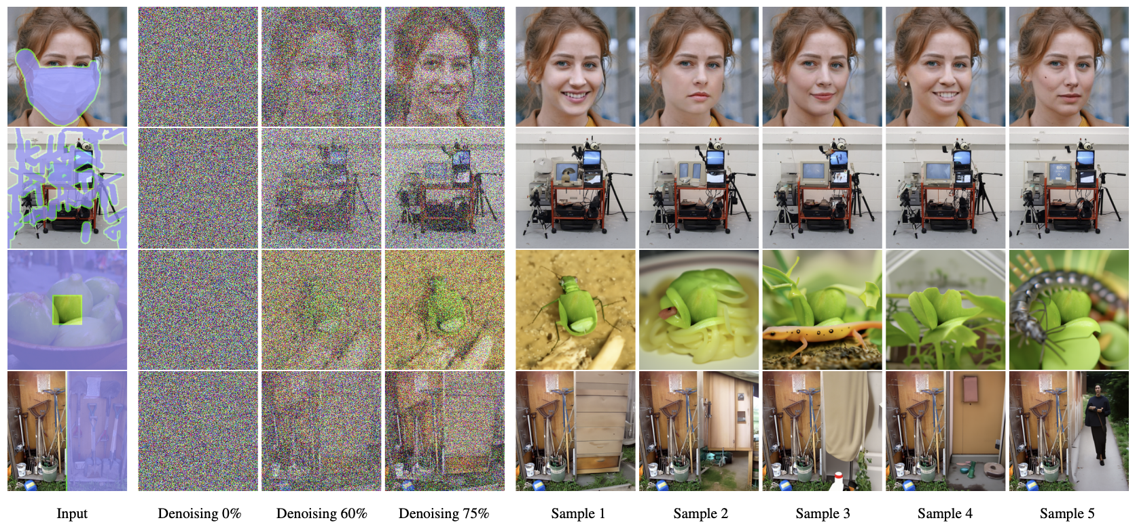
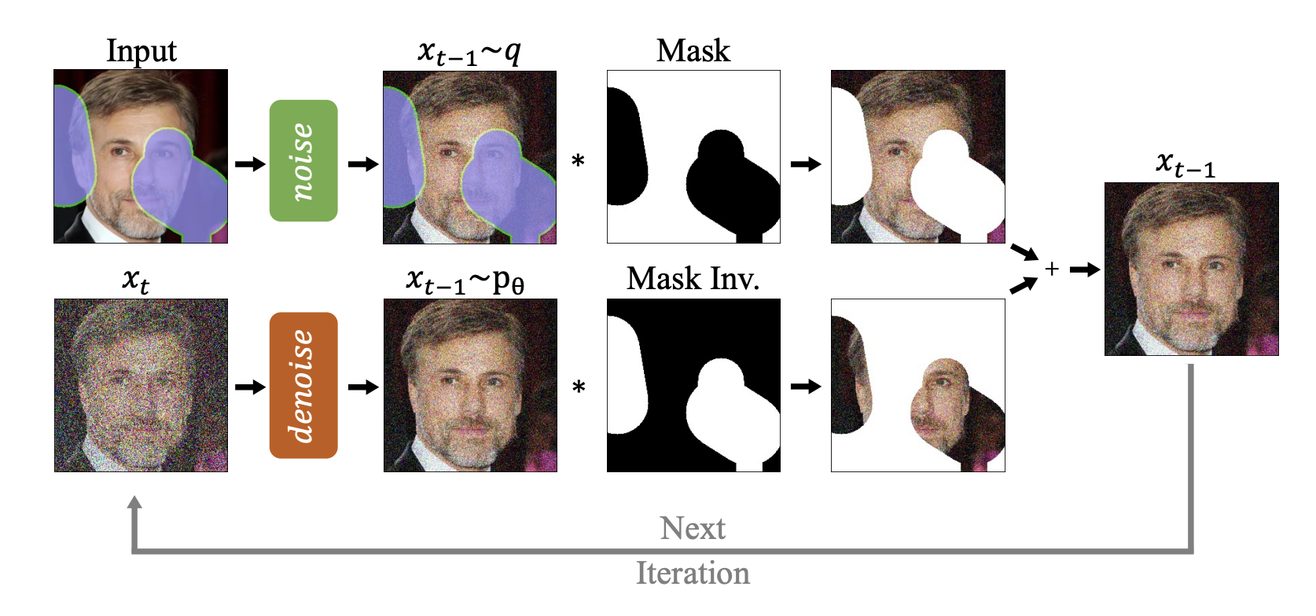
Applications
Computer Vision – inpainting
Notes:
An easy extension is inpainting. This is a feature you might have seen in the new Dall-E on ChatGPT Plus.

Slide 6
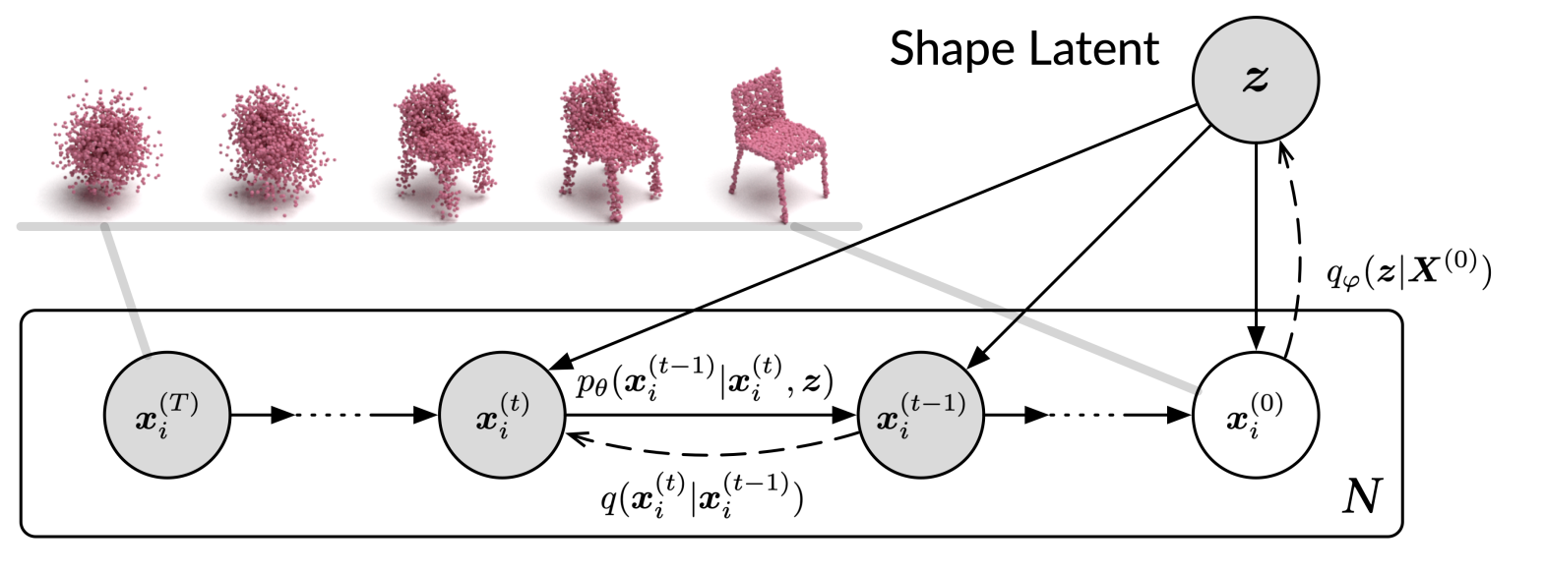
Applications
Computer vision – point cloud generation
Scans often miss information due to partial observation or occlusion.
Use diffusion models to infer missing parts.
Treat the points in a cloud as a set of particles in an evolving thermodynamic system.
Notes:
For anyone who doesn’t know, point clouds are 3D representations of real world objects

Slide 7
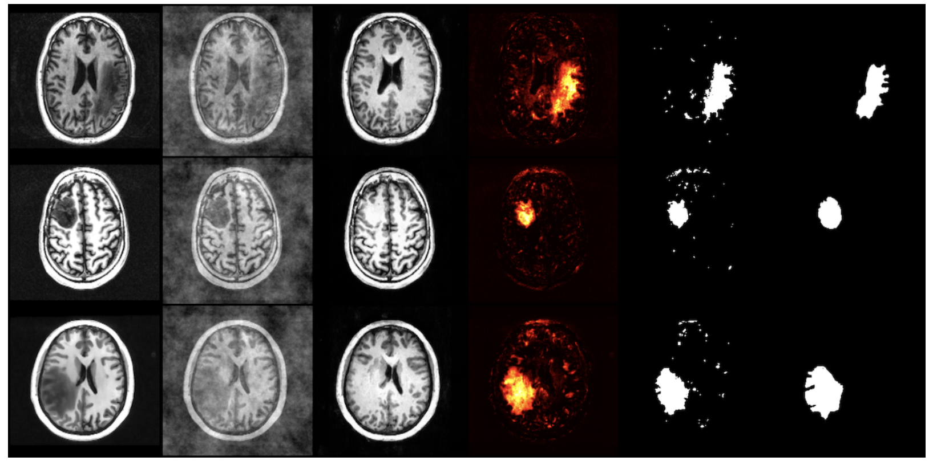
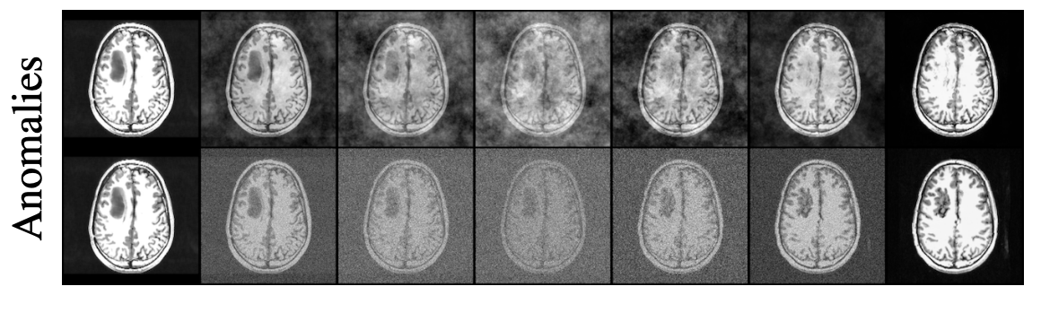
Applications
Computer vision – anomaly detection
AnoDDPM – attempt to “repair” patient data:
Instead of adding Gaussian noise, add power law noise
Notes:
Natural images have a power law distribution of frequencies.
Therefore low frequency components contribute more to the image. Gaussian noise on the other hand has a uniform spectral density. What this means is that low frequency components of partially diffused images do not become corrupted to the same degree as high frequency elements.
When you’re looking for anomalies in images this is bad, because low frequency components are interpreted as being corruption-free and therefore large anomalous regions will simply be reconstructed.

Slide 8
Applications
Natural language generation
Due to the success of ChatGPT, we tend to forget that Stable Diffusion 2 was released BEFORE GPT-4.
It is reasonable to think that there might be some good diffusion-based language models…
…but LLMs are still king in this arena
For a detailed exploration of why see:
https://sander.ai/2023/01/09/diffusion-language.html

Slide 9
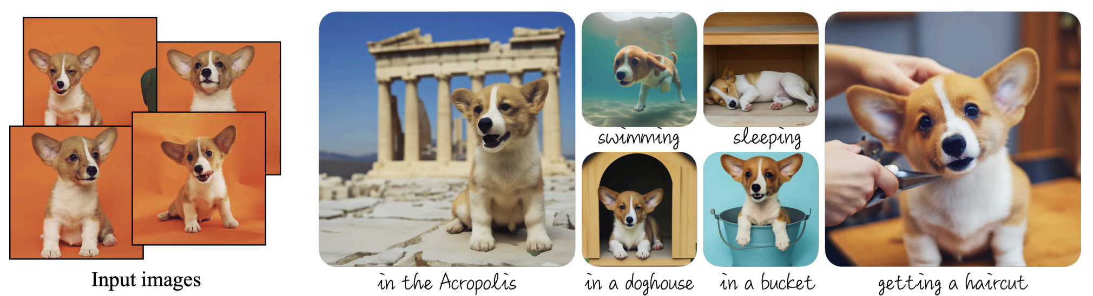
Applications
Multimodal generation – text-to-image
We already covered SD, but there are numerous other models:
DALL-E 1,2 and 3
Imagen
GLIDE
VQ-Diffusion
There are also models which build upon latent diffusion models:
DreamBooth – a method of fine tuning pretrained models

Slide 10
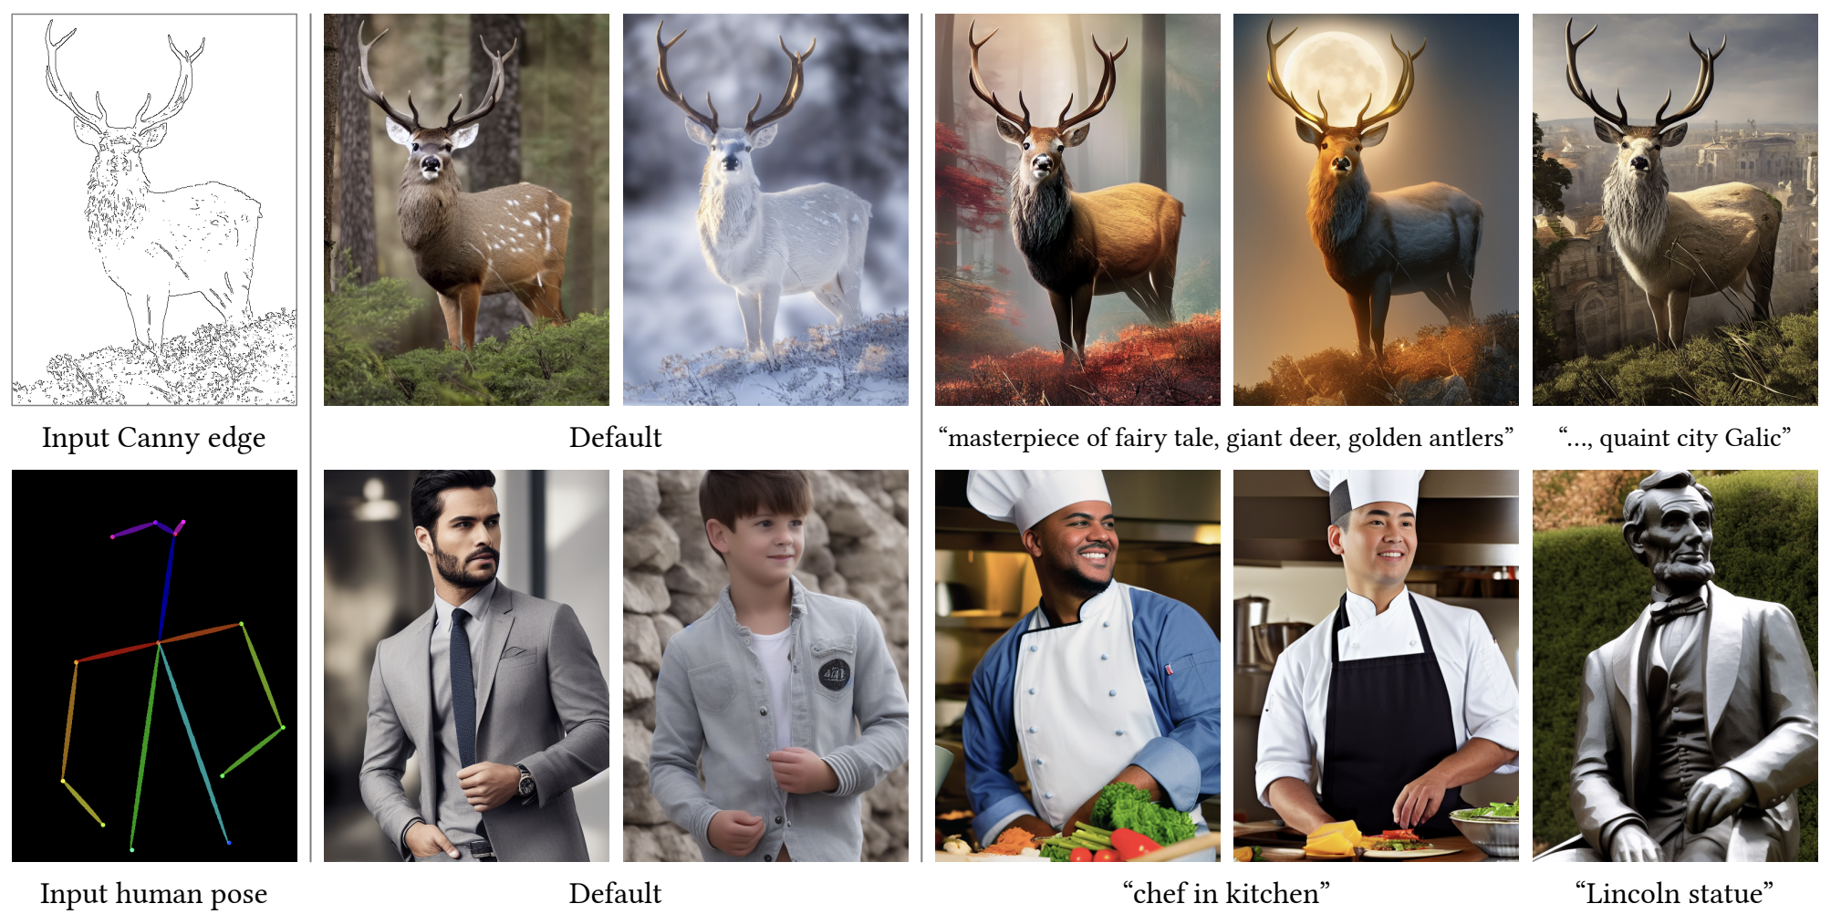
Applications
Multimodal generation – text-to-image
ControlNet – additional spatial conditioning controls:

Slide 11
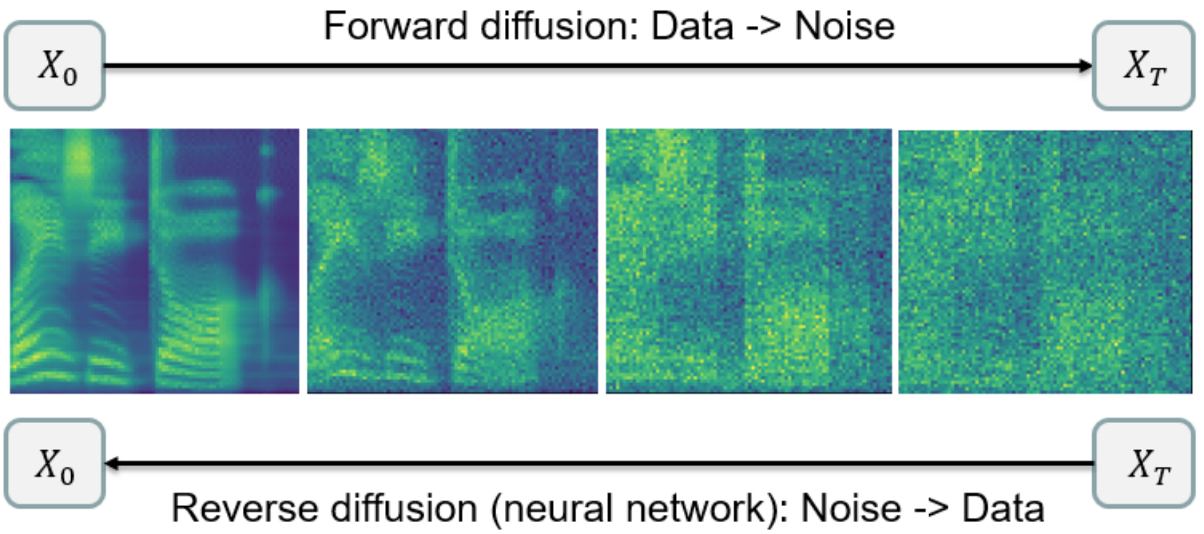
Applications
Multimodal generation – text-to-audio
Grad-TTS – text-to-speech:

Slide 12
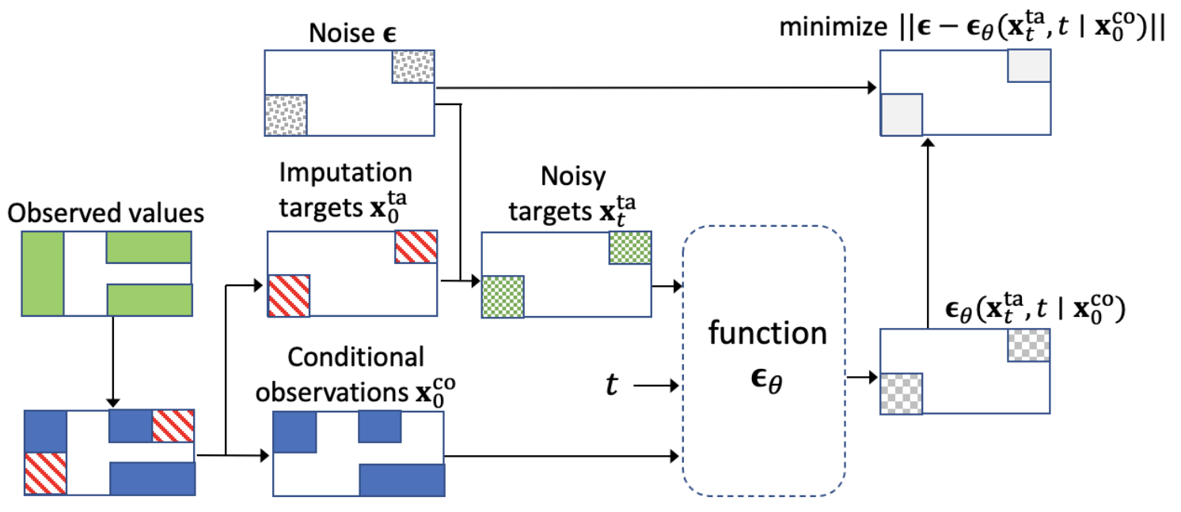
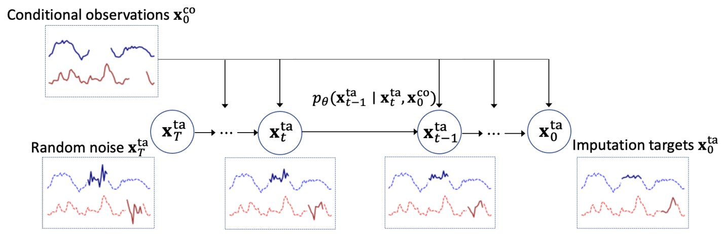
Applications
Temporal data modeling – imputation
Real world time series data often contains missing information
Imputation is the process of filling in that missing data:
Notes:
Conditional Score-based Diffusion Models for Probabilistic Time Series Imputation
Start with random noise on the left and gradually convert to a plausible time-series. Condition on observed results.
We might not have ground truth (or even missing values), so we use inspiration from masked language modelling – separate observed values into conditional information and imputation targets.

Slide 13
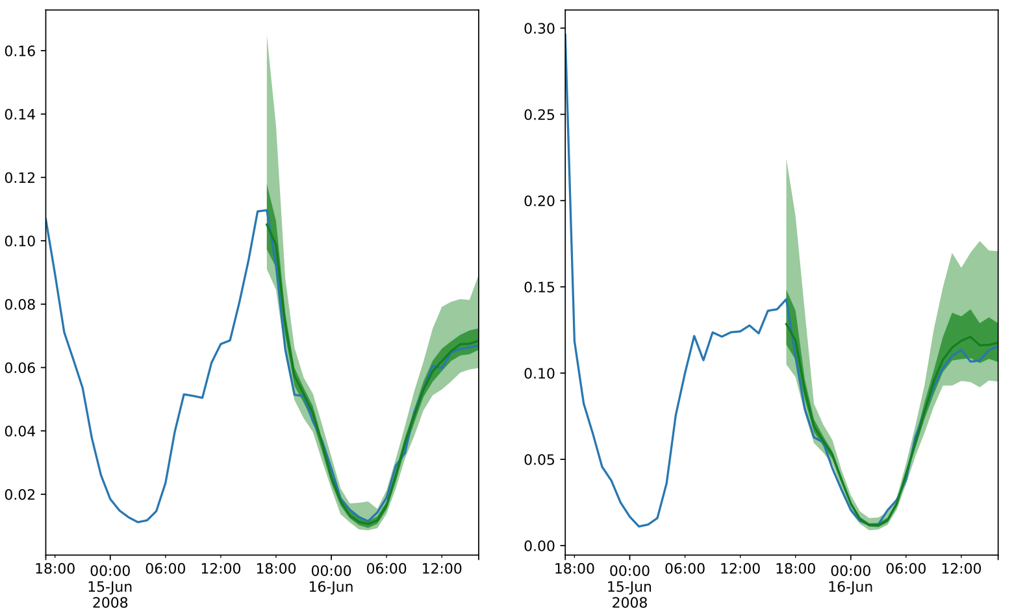
Applications
Temporal data modeling – forecasting
TimeGrad – multivariate probabilistic time series forecasting
Uses a RNN to predict traffic data…

Slide 14
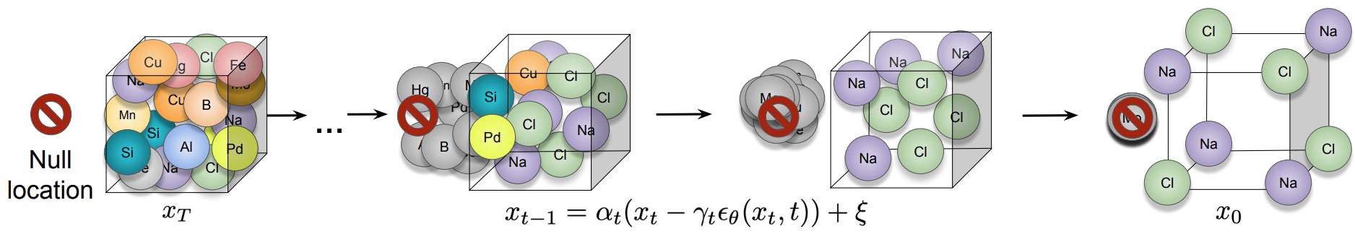
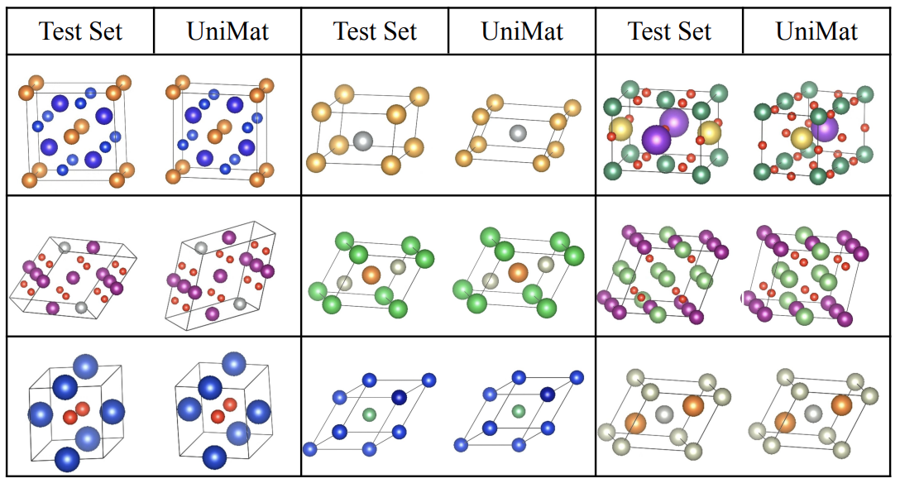
Applications
Materials
Scalable diffusion for Materials Generation, DeepMind

Slide 15
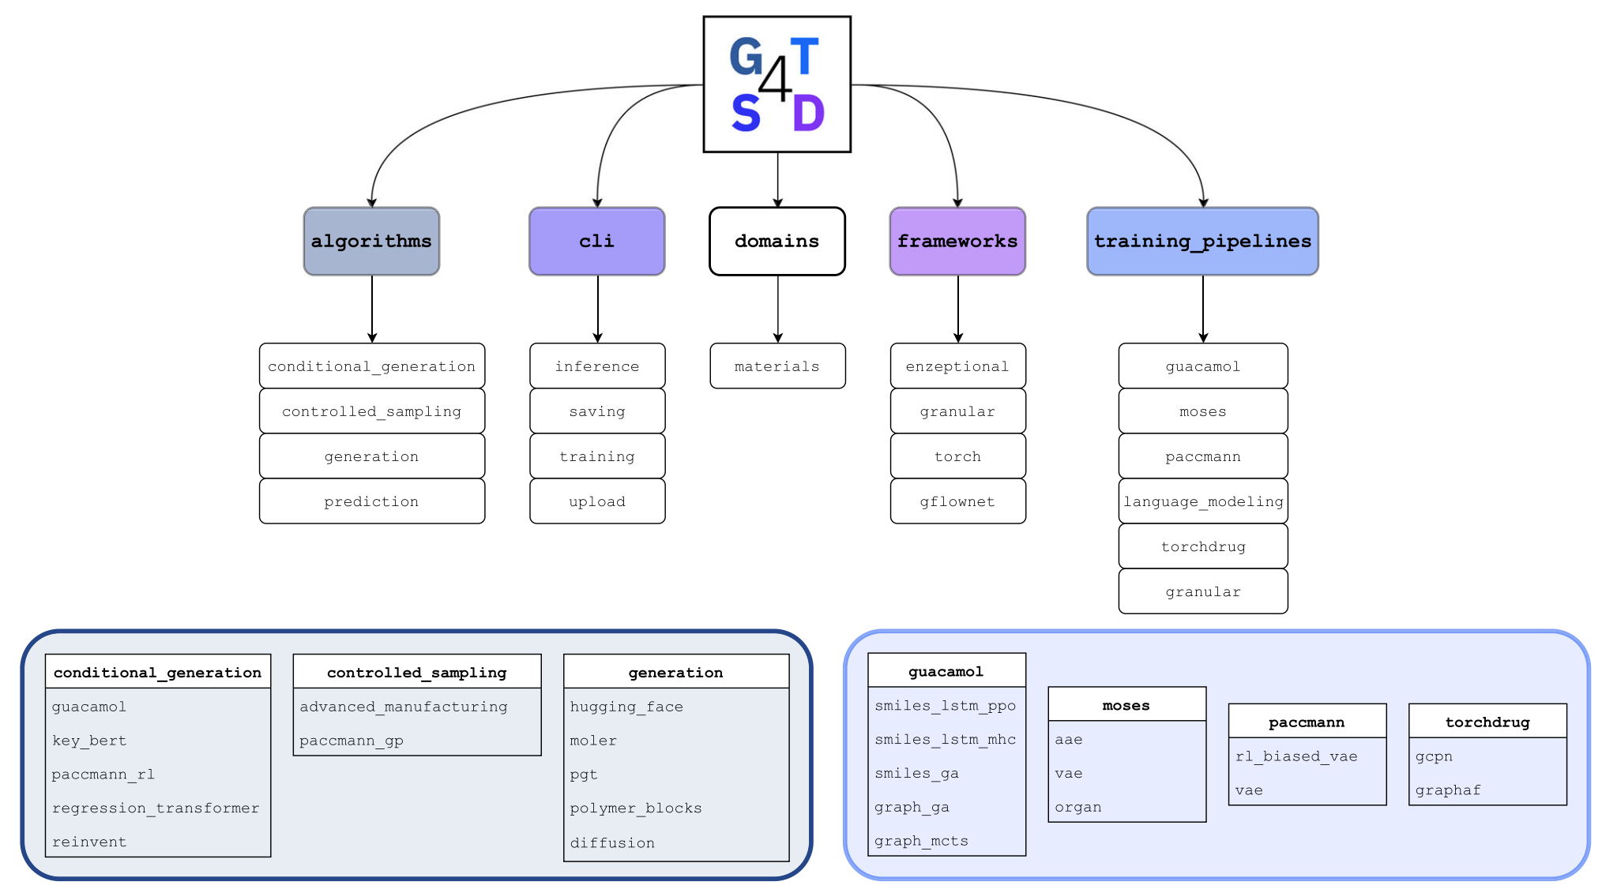
Applications
Materials
Generative toolkit for scientific discovery
Notes:
Molecular structure, text-based SMILES, or graph based
In AlphaFold 2 the final structure was realised using a Structure Module using invariant point attention. For AlphaFold 3 we replaced it with a relatively standard non-equivariant point-cloud diffusion model over all atoms (Algorithm 18 and Main Article Fig. 2b). During training, we train a denoiser to remove Gaussian noise from the positions of all heavy atoms conditioned on the features from the main trunk. The denoiser is based on a modern transformer, but with several modifications to make it more amenable to the task

Slide 16
Evaluating Diffusion Models

Slide 17
Evaluation
How can we effectively evaluate diffusion models?
How you choose to evaluate will be heavily dependent upon the task
The maturity of the metrics will also depend on the task
Evaluation for stable diffusion models will be significantly more advanced than for almost all other fields.
For many tasks, evaluation metrics will be whatever you are familiar with
E.g. for segmentation intersection over union
For imputation RMSE

Slide 18
Evaluation
Stable Diffusion Models – qualitative methods
Involves human assessment of generated images
Quality is measured across a range of aspects:
Compositionality
Image-text alignment
Spatial relations
Outputs are measured for common prompts of varying degrees of difficulty:
DrawBench
PartiPrompts

Slide 19
Evaluation
Stable Diffusion Models – quantitative methods
Text-guided
CLIP score – measures the compatibility of image-caption pairs
Semantic similarity between image and caption
Higher CLIP score is better
CLIP score is highly correlated with human judgement
Image-conditioned
Generate an image with a prompt (e.g. “A picture of a majestic Tonkinese cat.”)
Feed image into the model with a prompt (e.g. “Make the cat into a samurai.”) to produce image A.
Feed image into the model with a second prompt (e.g. “Make the cat into a businesscat.”) to produce image B
We then look at the change in the CLIP score between image A and B and between the change in the two captions
The higher the better
We can also measure the similarity between the original image, and the changed image

Slide 20
Evaluation
Stable Diffusion Models – quantitative methods
Class-conditioned models are pretrained on a class-labeled dataset.
Frechet Inception Distance (FID)
Kernel Inception Distance
Inception Score
FID
Find the Frechet distance between Gaussians fitted to feature representations of Inception.
Use the Inception v3 model and cut off the final classification layer
Get the ImageNet dataset (or a subset of it)
Generate a bunch of images
Stuff both generated and ImageNet images into Inception and get the feature representations
Fit two Gaussians to the representations
Compute the Frechet Distance.
Notes:
FID – Measure of similarity between two datasets

